Slide 1
Backend Engineering
Khushpreet Kaur 2310992123
Khushi 2310992121
Yuvika 2310992568
Komal 2310992125
Faculty Coordinator: Dr. Kirandeep Singh
:
Chitkara University Institute of Engineering and Technology,
Chitkara University, Punjab

Slide 2
INTRODUCTION
This project focuses on building a simple and functional registration form with both frontend and backend working together smoothly.
The frontend uses HTML, CSS, and JavaScript to create a user-friendly interface where users can enter their details, like name and email.
On the backend, a Node.js server handles saving this information into a JSON file when users submit the form. It also retrieves and sends back the saved data whenever needed, making it easy to display the information on the frontend.
The project highlights the entire process of collecting, storing, and displaying user data in a straightforward and efficient way.

Slide 3
TECHNICAL DETAILS
Frontend
HTML Form: Created a registration form with input fields for Name, Email, and Password, styled for a professional and user-friendly interface.
CSS Styling:
Responsive Design: Ensures the form adjusts seamlessly across various devices.
Interactive Elements: Includes smooth transitions, focused input animations, and hover effects for buttons and links, enhancing user interaction.
JavaScript Integration: Captures user input and sends it to the backend server via a POST request. Retrieves and displays user data from the backend in a clean, readable format.

Slide 4
TECHNICAL DETAILS
Backend
The backend of this project is built using Node.js and is designed to handle requests from the frontend, process data, and store user information in a file called User.json. Here's how it works:
Node.js Server:
The backend runs on a Node.js server, which listens for requests on port 3000.
It handles two types of requests: GET for retrieving data or files and POST for saving user information.
GET Requests
The backend handles GET requests to send files or data:

Slide 5
TECHNICAL DETAILS
Home Route (/):
Reads the User.json file, which contains all registered user data.
Sends the data back to the frontend in JSON format.
If there’s an error (like the file not being found), it sends a Server Error (500) message.
Other Routes:
/allstudent: Serves a webpage (allstudent.html) that might display information about all users.
/register: Serves the registration form (Login form.html) to users who want to sign up.
Invalid Routes:
If the user tries to access a route that doesn’t exist, the server sends a 404 Not Found message.

Slide 6
TECHNICAL DETAILS
POST Requests
The backend processes and saves user data when it receives a POST request:
Registration Route (/register):
Collects the data submitted by the user (like name, email, and password).
Reads the User.json file to check if it already contains user data:
If the file is empty, it starts with an empty list.
If there’s existing data, it parses the file to add the new user to the list.
The new user information is saved back to User.json.
Responds with a success message once the registration is complete.

Slide 7
TECHNICAL DETAILS
Error Handling:
If there are issues reading or writing to the file, the server logs the errors and ensures the frontend is informed with a proper error message.
How Data is Stored
All user data is stored in a single file, User.json, in JSON format.
The data is structured as a list of user objects (e.g., [{name: "John", email: "john@example.com"}]), making it easy to retrieve and update.
How It Works Together
When a user submits the registration form on the frontend, the data is sent to the backend via a POST request.
The backend processes the data, saves it in User.json, and sends back a confirmation message.
When needed, the frontend can request all stored user data by sending a GET request to the backend.

Slide 8
KEY FEATURES
Key Features
Interactive Frontend: Seamless user experience for data submission and retrieval.
Dynamic Backend: Efficient handling of GET and POST requests with error handling for missing routes.
Persistent Storage: User data is saved in JSON format for easy retrieval and updates.
Scalable Design: The backend can be extended to support more features and routes.

Slide 9
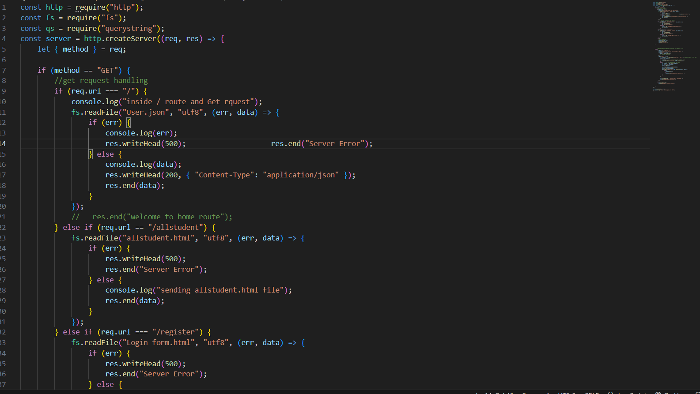
Code

Slide 10
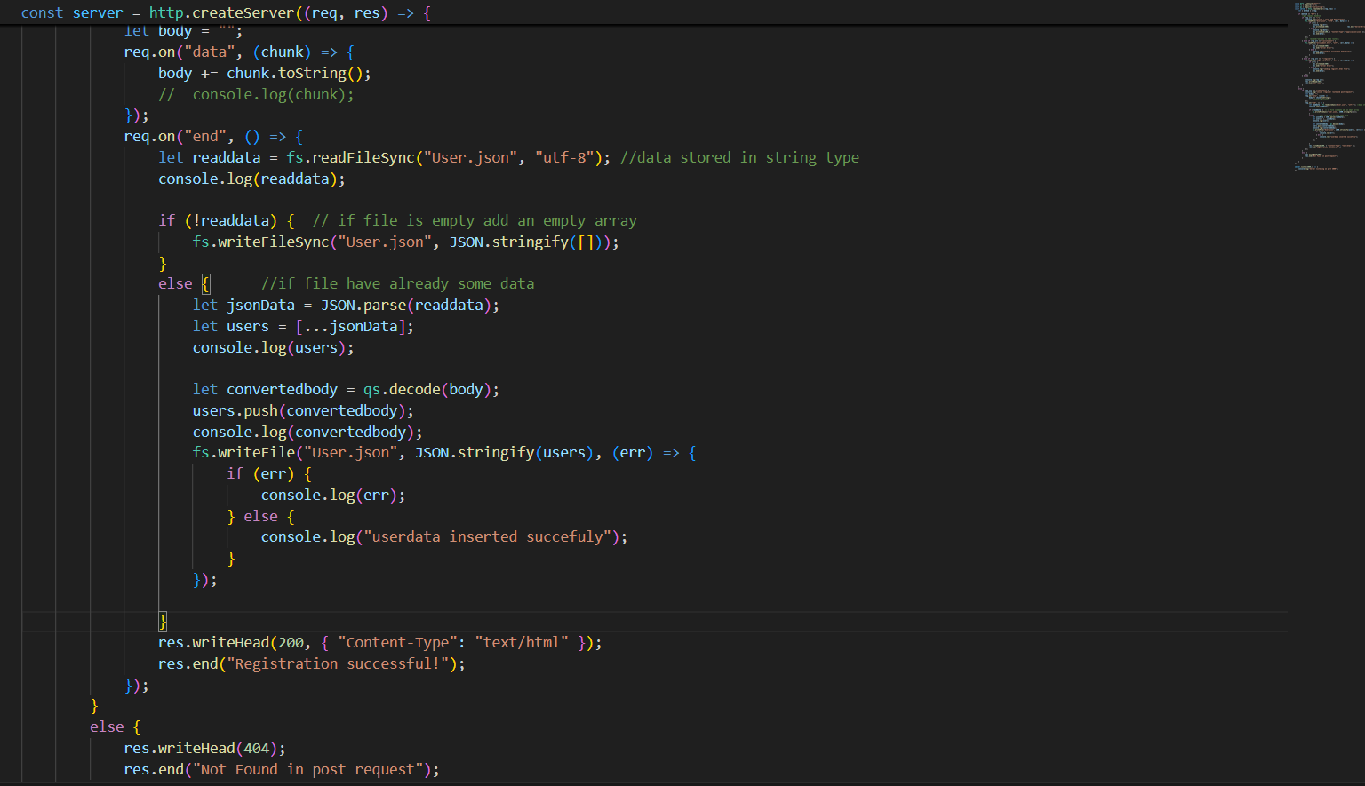
Code

Slide 11
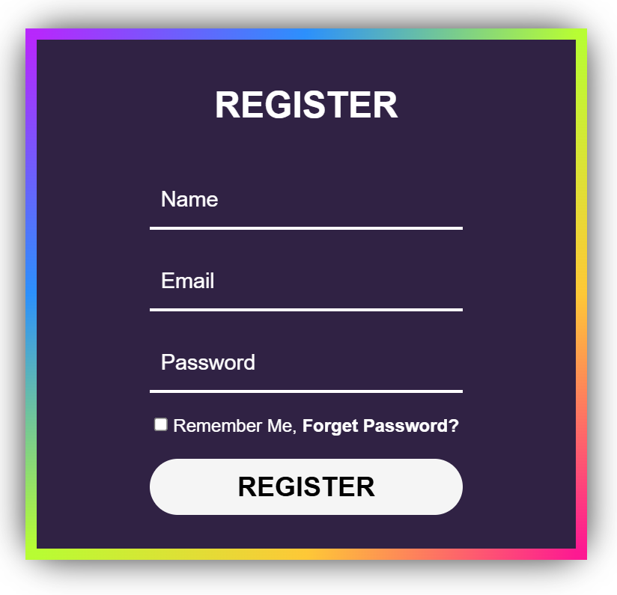
Result

Slide 12


